Slide 1
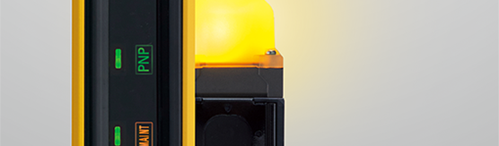
F3SG-SR Safety Light Curtain
Kenny Heidel – Safety Product Manager

Slide 2
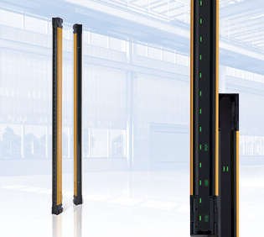
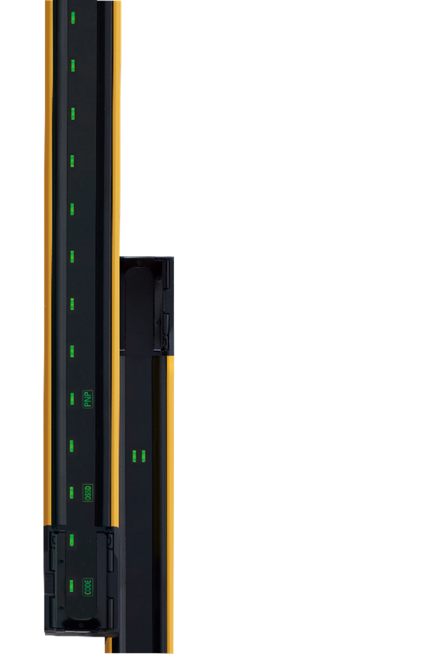

F3SG-SR/PG Safety Light Curtains
F3SG-SR/PG is the latest and most advanced safety light curtain designed to:
  Reduce installation and configuration time
  Give customers ultimate flexibility in their machine safety designs
  Maximize machine uptime with enhanced diagnostic features

Slide 3

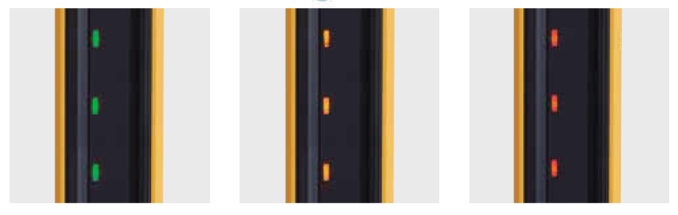
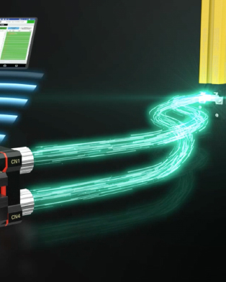
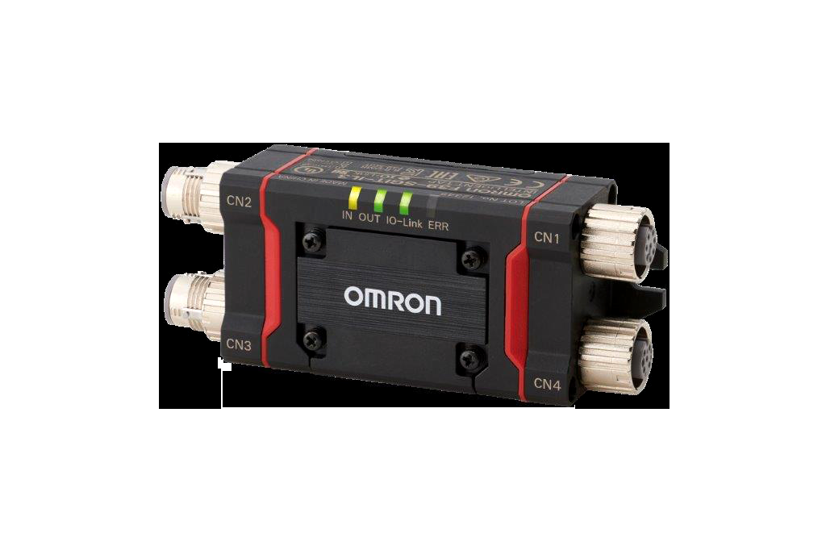
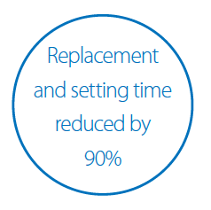
F3SG-SR Customer Benefits
Reduce Installation and configuration time
Tri-Color Area Beam Indicators (ABI)
Intelligent Tap
Notes:
3 sets of Area Beam Indicators (ABIs) to identify if the light curtains are aligned properly, as well as if there are any obstructions or failures related to the different light transmitters and receivers.
Green – Beams are unblocked
Yellow – Check alignment or see if the light curtain is dirty
Red – Beams are blocked
Also, it has built in auto-sense for NPN and PNP to reduce the possibility of miss-wiring outputs
The intelligent tap enables saving of the light curtain configuration. This can be copied to other light curtains in the event of replacement or similar application. Instead of having to re-program the light curtain, the settings can be uploaded in seconds. It also enables IO Link communication.

Slide 4

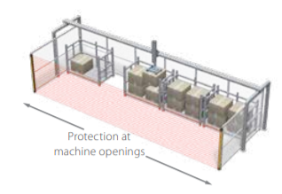
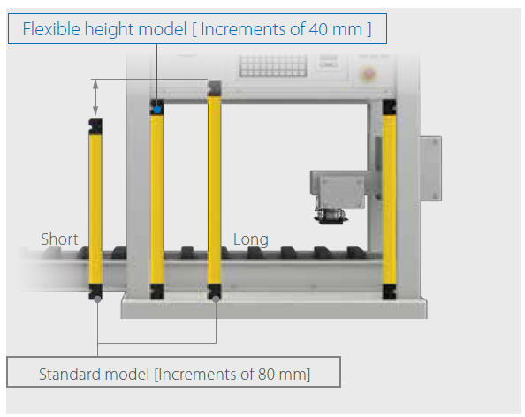

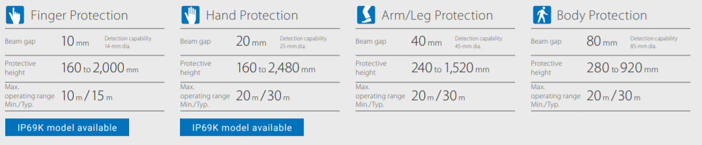
F3SG-SR Customer Benefits
Ultimate machine safety design flexibility
Sensing range up to 30m (25mm and above)
Flexible height with 40mm increments
Notes:
No matter the application, we have a light curtain for it. The 30m sensing range shows how strong our transmitters are and are able to be immune to dust and debris.
Omron is the only company that offers light curtains in 40mm increments. This small increment allows the F3SG-SR to have the correct height for just about any application, as long as the safe sensing distance is achieved.

Slide 5

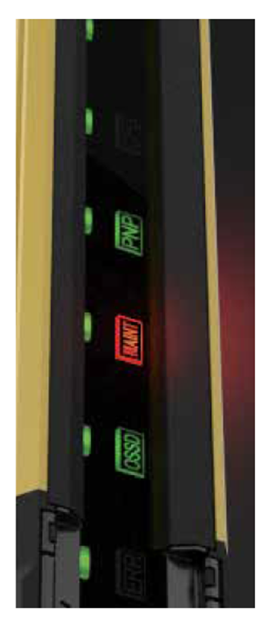
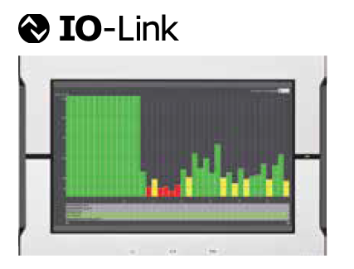

F3SG-SR Customer Benefits
Maximize machine uptime
Local visual diagnostics on ABIs
IO Link communication
Notes:
The LED indicators have labels to help identify the issue with that LED. There are a few patters of blinking yellow and blinking red to help maintenance personal quickly troubleshoot and issue and alleviate it.
IO Link communication enables both process data (i.e. auxillary output status, muting input status, OSSD output status, etc.) and service data (light curtain settings, internal status information, intelligent tap information) to be communicated to an HMI or other equipment for analysis

Slide 6
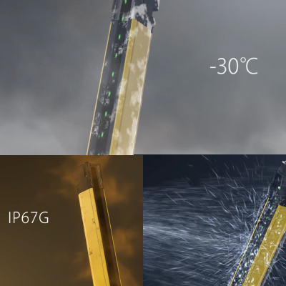
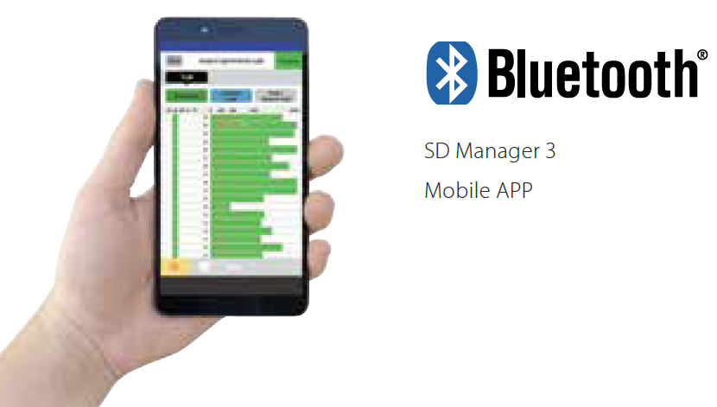

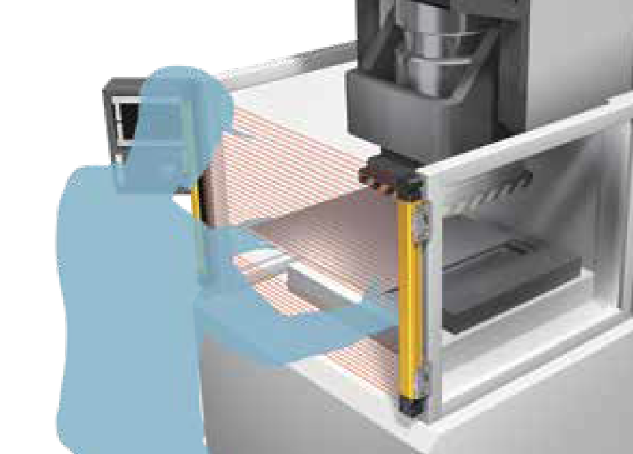
F3SG-SR Additional Features
And many more cool features:
  IP67G rating for harsh environments
  -30°C to +55°C temperature range
  PNP/NPN compatible in same model
  New SD Manager 3 with best-in-class muting and Bluetooth capability
  Pre-Reset capability (with associated button)
Notes:
IP67G and temperature ratings to cover harsh environments. Future release of IP69K for food and beverage customers as well
Auto-sense PNP/NPN allows for no more miss wiring of the outputs
New SD Manager 3 helps program the light curtain and has a mobile app (Android on initial release, followed by Apple app in 2020)
Pre-Reset is only in industry. This helps protect machines with blind spots and will not restart the machine until the worker has passed back through the light curtain to press the machine start button
PSDI capability helps speed up throughput because workers are not required to press a two hand control switch

Slide 7
Intelligent Tap F39-SGIT-IL3: What is it?
The Intelligent Tap is the configuration method for the F3SG-SR.
Configuration can be done either via DIP Switches or via SD Manager 3 software
Provides program backup/restore capabilities
Required for IO Link communication

Slide 8
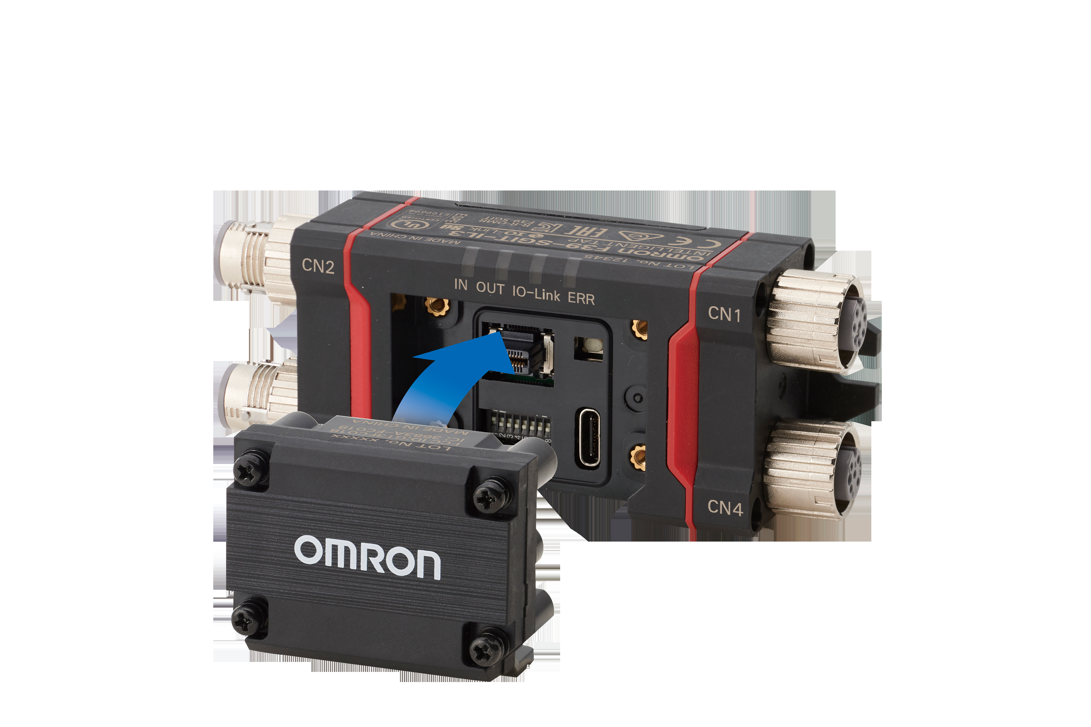
Intelligent Tap F39-SGIT-IL3: PC-Free Programming
The following functions are programmable without a PC via the DIP Switch Settings:
Interlock (auto reset/manual reset)
Pre-reset with associated button (on/off)
External Device Monitoring (on/off)
Fixed Blanking (on/off)
Floating Blanking (on/off)
Operating Range Selection (long/short)
These capabilities and all other of F3SG-SR can be done via Bluetooth or USB-C connection to a PC with SD Manager 3 (i.e. Pre-Reset, PSDI, Reduced Resolution, etc.)
Notes:
Note – these are minor programming capabilities. For the full programming capability, customers should use the SD Manager 3

Slide 9
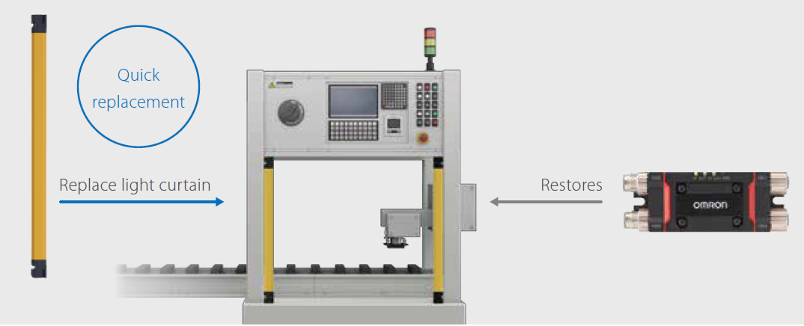
Backup/Restore Capability
Intelligent tap stores program from F3SG-SR light curtain (only 1 program is stored)
  Note – If more than 1 program is needed, you can create as many programs as you need in SD Manager 3, save them to your PC, and then upload to the Intelligent tap when necessary
In the event that an F3SG-SR is damaged, the replacement can be installed and on power cycle while connected to the Intelligent tap, the stored program will automatically upload to the new light curtain
Notes:
The intelligent tap enables saving of the light curtain configuration. This can be copied to other light curtains in the event of replacement or similar application. Instead of having to re-program the light curtain, the settings can be uploaded in seconds.

Slide 10
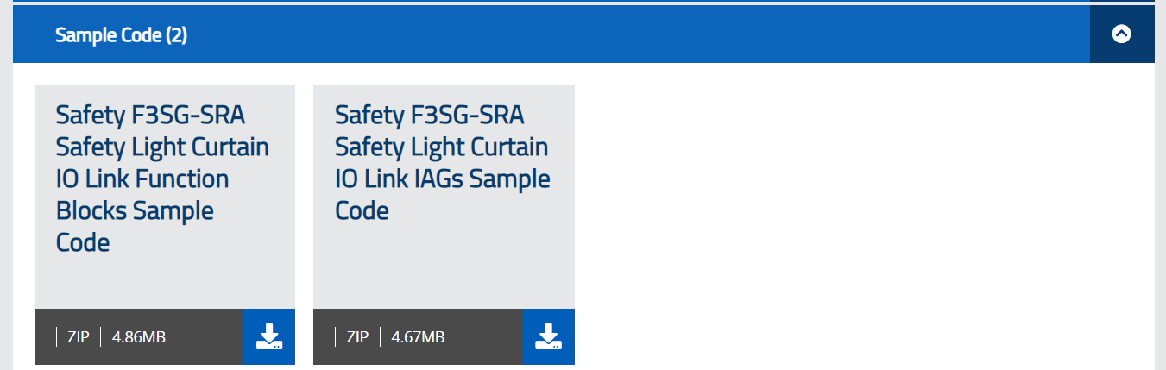

IO-Link: Predictive Maintenance Information
Through IO-Link, users can have access to all process and service data information
Omron has developed IAGs (HMI screens) to aid in visualization of this data. Must log into OmronNow on our website.

Slide 11
Intelligent Tap – When it is needed and when is it not needed?
Required? | Application | Limitations | Notes
Required | Any configuration of F3SG-SR can be enabled. For example: External Device Monitoring (EDM) Muting Floating Blanking Fixed Blanking Reduced Resolution Pre Reset PSDI Long/Short range configuration IO-Link Communication | Additional piece of hardware in the system (sold separately) | *If you are not using IO-Link, F3SG-SR can be programmed with the Intelligent Tap and then the Tap can be removed and stored in a safe location. *A single Intelligent Tap can program infinite numbers of light curtains *Intelligent Tap can only store 1 program at a time
Not Required | Standard functionality: Basic on/off Auto-Reset No External Device Monitoring (EDM) required | No advanced configurations can be enabled | If you setup light curtains in wired synchronization, you get ABIs on transmitter and receiver. Through optical synchronization, you only get ABIs on the receiver.

Slide 12
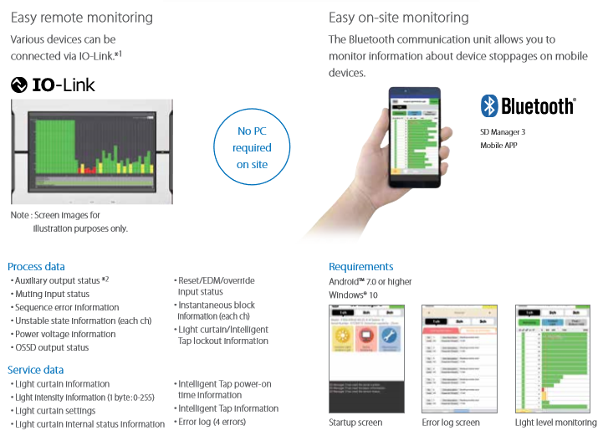
F3SG-SR with IO-Link and Bluetooth
Notes:
This is the information you can receive over IO Link

Slide 13
Product Positioning

Slide 14
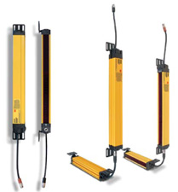
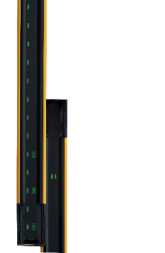
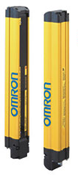
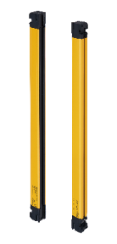
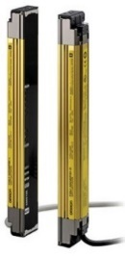
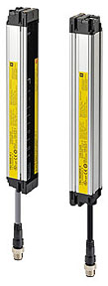
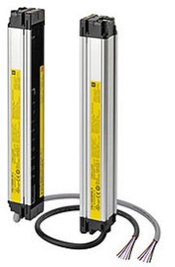
Omron Safety Light Curtains Positioning
MS4800
List Price
F3SG-SRA
F3SG-RA
F3SG-SRB
F3SJ-A
F3SJ-B
F3SJ-E
F3SG-RE
Features and Functionality

Slide 15
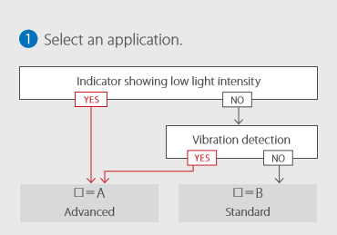
What is the difference between F3SG-4SRA and SRB
F3SG-4SRA
  Area beam indicators (ABI)
  Vibration sensor
F3SG-4SRB
  Is an advanced light curtain that offers all the features of the F3SG-4SRA except the two features above

Slide 16
Target Industries

Slide 17
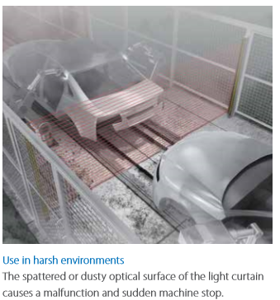
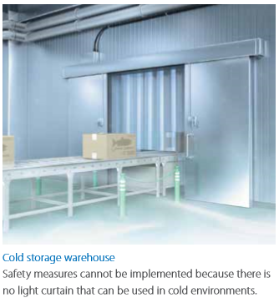
Target Applications/Industries
Applications
  Automotive
    Robotic welding cells, Robotic Assembly cells, Assembly line guarding
  F&C
    Conveyors, Packaging Machines, Processing Machines
Food and Commodities Applications
  IP69K rating for meat & poultry customers
  Enhanced temperature range; -30°C to 55°C for refrigerated food applications

Slide 18
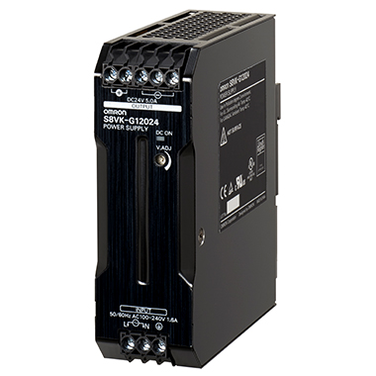
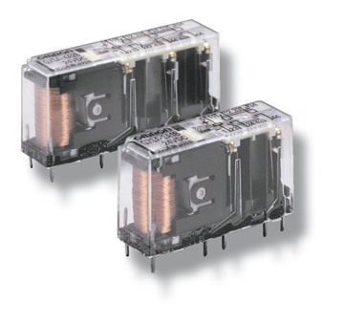
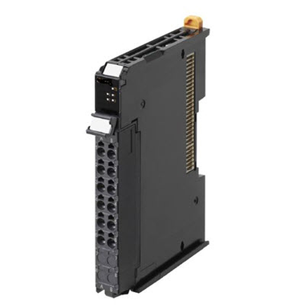
Bundling with other Omron products
S8VK Power Supplies
E3Z-T/R_ _ _ Photoelectric sensors for muting
XS5W-D421-_ _ _ _ _ Cables for connecting E3Z-T/R
G7SA/G9SE – Safety Relays
NX-ILM400/GX_ _ I/O Link modules
A16/A22 Pushbuttons
M22 Indicators
GX-ILM08C - IAG Status Screen that reads I/O Link data sets
Notes:
Possible other Omron products that can be used with the F3SG-SR series

Slide 19

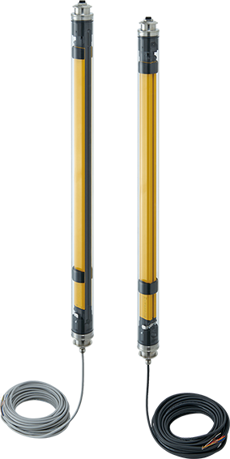
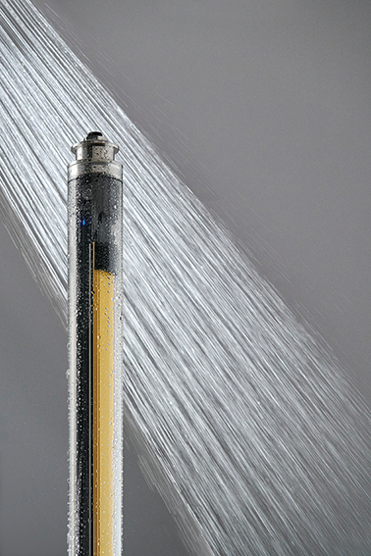
F3SG-SRB IP69K
F3SG-SRB with IP69K enclosure now available
14mm and 25mm resolution available
15m pre-wired cable attached to the end
Blue LED alignment at top and bottom of light curtains
Protection range advantage!
  14mm – 8m/12m (Min/Typ)
  25mm – 16m/24m (Min/Typ)

Slide 20
Target Applications – Primary Processing
Anything that can growth bacteria - meat, poultry, seafood, eggs, milk, yogurt, raw bread, raw cookie dough, ice cream, pharmaceuticals, iced tea, beer, fresh vegetables, fresh fruit, etc. Example machines are:
  Food processing machinery
  Fresh produce machinery
  Dairy processing machinery
  Pharmaceutical machinery
  Chemical processing equipment
  Outdoor equipment
  Medical Applications

Slide 21
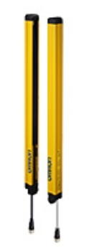
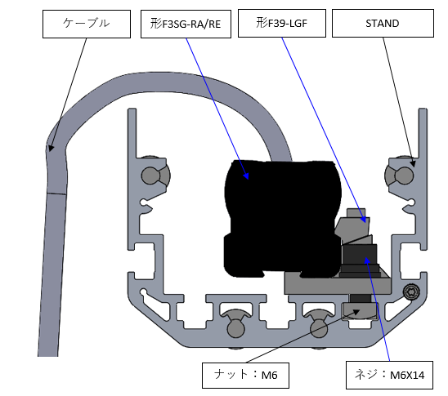



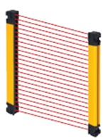
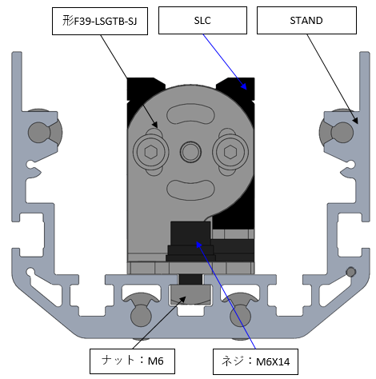

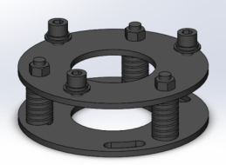
F3SG-SR Accessories: Stand, Mirror, and Rotatable Base
F3SG-R
F39-STXXXX
F39-SMLXXXX
F39-PMLXXXX
F3SG-R
F3SG-SR
F3SG-SR
By providing three T-slots for mounting, multiple options are available.
F3SG-SR/PG
F3SG-PG
F39-STB

Slide 22
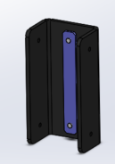
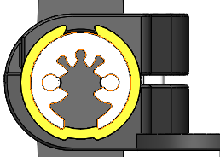
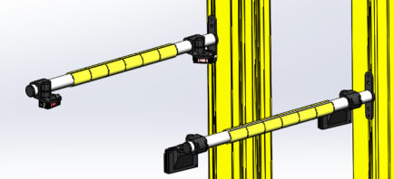
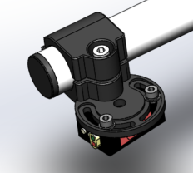
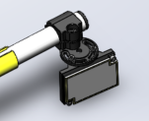
F3SG-SR Accessories: F39-FMA Mounting Arm
Mountable to F3SG-SR/PG, or F39-ST stand
Pass through for sensor cables
E3Z thru beam and retro-reflective can be mounted.
FMA structure
When mounting to the SLC, use the dedicated metal fitting.
Photoelectric sensors cables
Cover cable (Rotate yellow parts to prevent falling out)
Depending on the sensor location, separate the cover to adjust the position and quantity
Sensor mounting
Regression reflector mounting
The circular arm is fastened with screws.
(Adjustable rotational direction)
Angle adjustable structure for reflector and sensor
Angular adjustable structure for the photoelectric sensors

Slide 23
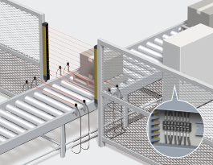
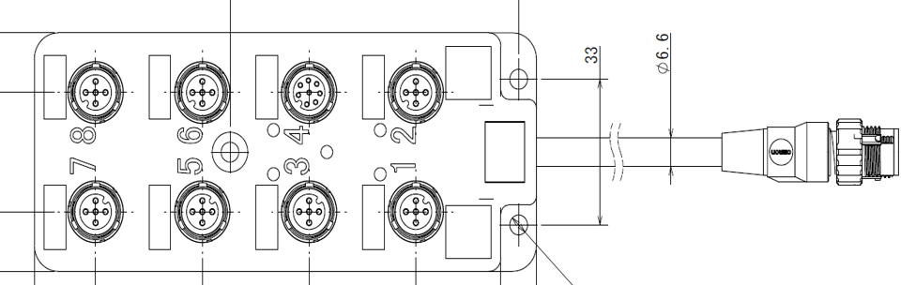
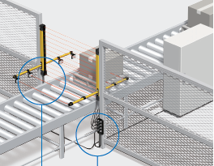
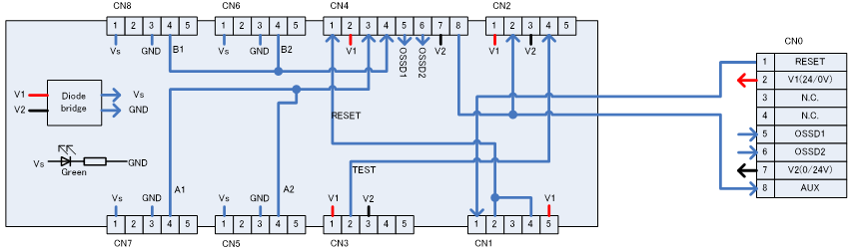
F3SG-SR Accessories: F39-GCN5 Muting Sensor Connector Box
CN0

Slide 24
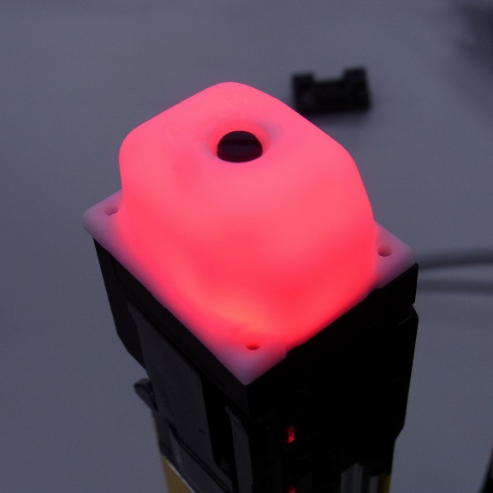
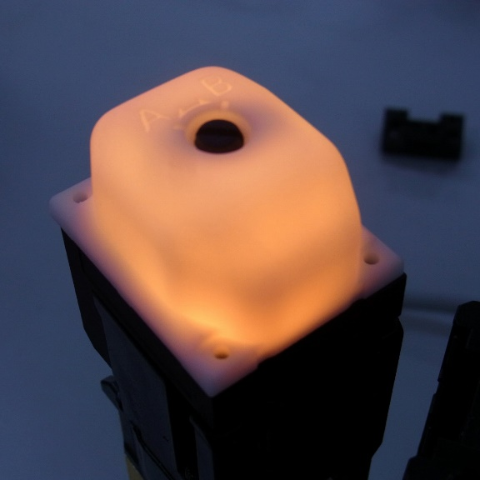

F3SG-SR Accessories: F39-SGLP
Basic concept is the same as that of existing F3SG-R
360° Light emission from each direction (viewable up to 10m)
Scan code setting available
Scan Code setting

Slide 25
F3SG-SR Ordering Information

Slide 26


F3SG-SR Model Number Structure

Slide 27

F3SG-SR IP69K Model Number Structure

Slide 28
Collateral
Description | Media | Publication Number
F3SG-SR/PG Brochure | PDF | F105I-E3-06
F3SG-SR/PG Datasheet | PDF | F1055I-E3-06
F3SG-SR/PG Manual | PDF | Z405I-E3-03
SD Manager 3 Programming information is now in the F3SG-SR/PG manual | PDF | Z405I-E3-03

Slide 29

F3SG-SR FAQs
Question | Answer
1. What does the –F mean on certain models? | 1. The –F stands for flexible height models. These models are 40mm increments from the previous length model. For example, F3SG-4SRA0160-14 does not have a –F, but the next height model, F3SG-4SRA0200-14-F does. There is no difference in performance between these two models.
2. Do the fixed mount brackets come with the F3SG-SR? | 2. As of April 2020, the F3SG-SR does not come with brackets. When quoting, make sure to add the necessary amounts of brackets.
3. Does the Intelligent Tap need to be connected all the time to the F3SG-SR/PG for it to work? | 3. No. The Intelligent Tap can be used to program the F3SG-SR/PG and once the program is uploaded to the light curtain, it can be removed.
4. To utilize IO-Link, do you need the Intelligent Tap? | 4. Yes, in order to use the IO-Link communication capability, you must have the Intelligent Tap installed at all times.
For more general FAQs, please visit Omron’s IA website.

Slide 30

F3SG-SR Key Takeaways
Reduced Installation and commissioning time
Machine safety design flexibility
IO Link communication and Bluetooth compatible

Slide 31



F3SG-SR/PG Safety Light Curtains
Your one-stop shop for the most comprehensive light curtain lineup on the market!
Machine Guarding
Perimeter Guarding
IP69K Rated Enclosure
All the Accessories

Slide 32


thank
you
contact name: Kenny Heidel
email: Kenny.Heidel@omron.com

